Slide 1
xVAs
Chapter 18

Slide 2
Simple Situations: Single Derivative and No Collateral
What is the exposure for
  Long position in option
  Short position in option
  Interest rate swap

Slide 3
CVA
Credit value adjustment (CVA) is the amount by which a dealer must reduce the value of transactions because of counterparty default risk

Slide 4
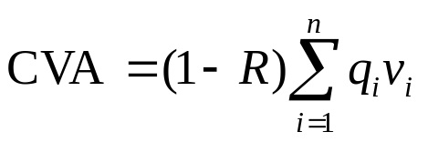
The CVA Calculation
………………
Time
0
t₁
t₂
t₃
t₄
t_{n}=T
………………
Default probability
q₁
q₂
q₃
q₄
q_{n}
………………
PV of expected net exposure
v₁
v₂
v₃
v₄
v_{n}
where R is the recovery rate

Slide 5

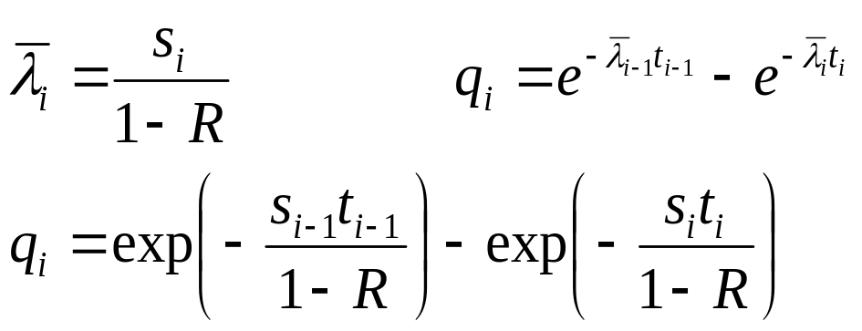
The Default Probabilities (equation 18.3)
The default probabilities (i.e., the q_{i}’s) are calculated from credit spreads
If s_{i} is the credit spread for maturity t_{i}, is the average hazard rate up to time t_{i} , and R is the recovery rate

Slide 6
The Expected Exposures
The v_{i} are calculated using Monte Carlo simulation. Random paths are chosen for all the market variables underlying the derivatives and the net exposure is calculated at the mid point of each time interval.
v_{i} is the present value of the average net exposure at the ith default time

Slide 7
The Expected Exposure
If no collateral is required, the exposure at each time for each random trial is max(V,0) where V is the value of the derivatives portfolio to the dealer
If the collateral equal to C is expected to be posted by the counterparty at the time of the default (with a negative C indicating collateral expected to be posted by the dealer), the exposure is max(V − C, 0)
This formula reflects the fact that the dealer will have an exposure if it has posted more collateral than the value of the derivatives to the counterparty.

Slide 8
Calculation of Available Collateral
It is assumed that there is a “cure period” (sometimes called margin period of risk) immediately before a default during which collateral is not posted
If cure period is c days on each Monte Carlo trial we must calculate the value of the portfolio c days before each default time
This determines the collateral available at the default time

Slide 9
Peak Exposure (Section 18.2.2)
A high percentile (e.g. 97.5%) of the exposure distribution at a particular tiem
Maximum peak exposure (peak of peaks) is the maximum of the peak exposures across all the times considered

Slide 10
Downgrade Triggers (Section 18.2.3)
Collateral required (or possibly early termination) if counterparty is downgraded below a certain credit rating
They work well if counterparty has relatively few of them
Examples: AIG, Enron

Slide 11
Incremental CVA
Results from Monte Carlo are stored so that the incremental impact of a new trade can be calculated without simulating all the other trades.

Slide 12
CVA Risk
The CVA for a counterparty can be regarded as a complex derivative
Increasingly dealers are managing it like any other derivative
Two sources of risk:
  Changes in counterparty spreads
  Changes in market variables underlying the portfolio

Slide 13
Wrong Way/Right Way Risk
Simplest assumption is that probability of default q_{i} is independent of net exposure v_{i}.
Wrong-way risk occurs when q_{i} is positively dependent on v_{i}
Right-way risk occurs when q_{i} is negatively dependent on v_{i}

Slide 14
Examples
Wrong-way risk typically occurs when
  Counterparty is selling credit protection
  Counterparty is a hedge fund taking a big speculative positions
Right-way risk typically occurs when
  Counterparty is buying credit protection
  Counterparty is partially hedging a major exposure

Slide 15
Problems in Estimating Wrong Way/Right Way Risk
Knowing trades counterparty is doing with other dealers
Knowing how different market variables influence the fortunes of the counterparty

Slide 16
Allowing for Wrong-Way risk
One common approach is to use the “alpha” multiplier to increase the v’s
Estimates of 1.07 to 1.1 for alpha obtained from banks
Regulators set alpha equal to 1.4 or allows banks to use their own models, with a floor of 1.2

Slide 17
DVA
Debit (or debt) value adjustment (DVA) is an estimate of the cost to the counterparty of a default by the dealer
Same formulas apply except that v is counterparty’s exposure to dealer and q is dealer’s probability of default
Accounting value of transactions with counterparty = No default value – CVA + DVA

Slide 18
DVA continued
What happens to the reported value of transactions as dealer’s credit spread increases?

Slide 19
Expected Exposure on Pair of Offsetting Interest Rate Swaps and a Pair of Offsetting Currency Swaps with No Collateral Posted (Figure 18.1)
Exposure
Currency swaps
Interest Rate Swaps
Maturity

Slide 20
Interest Rate vs Currency Swaps
The q_{i}’s are the same for both
The v_{i}’s for an interest rate swap are on average much less than the v_{i}’s for a currency swap
The expected cost of defaults on a currency swap is therefore greater.

Slide 21
Simple Example: Single transaction which provides a payoff at time T years and always has positive value to dealer
CVA has the effect of multiplying value of transaction by e^{−sT} where s is spread between T-year bond issued by counterparty and risk-free T-year bond
DVA is zero

Slide 22
Example 18.2
A 2-year option sold by a counterparty to the dealer has a Black-Scholes value of $3
Assume a 2 year zero coupon bond issued by the counterparty has a yield of 1.5% greater than the risk free rate
If there is no collateral and there are no other transactions between the parties, value of option is 3e^{−0.015×2}=2.91

Slide 23
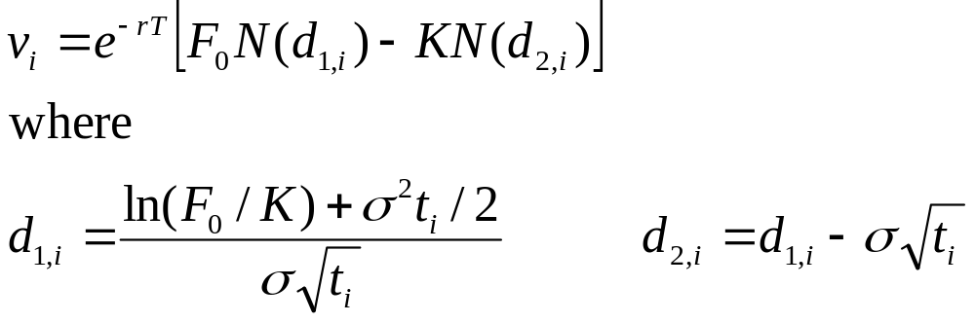
Dealer Has Single Uncollateralized Long Forward with Counterparty (Section 18.7.3)
The value of a long forward contract at time t is
(F_{t}−K)e^{−r(T−t)}
The exposure at time t is e^{−r(T−t)} max(F_{t}−K, 0)
Using the Black-Scholes-Merton result to calculate the present value of E[max(F_{t}−K, 0)] gives

Slide 24
FVA
FVA, Funding Value Adjustment, considers the situation where a bank enters into a transaction with a client where no margin is posted and hedges this by entering into an offsetting transaction with another bank, e.g.:
Corporate
Client
2.9%
Bank A
3.0%
Bank B
Floating
Floating

Slide 25
FVA continued
Swap with bank will be cleared through a CCP and bank will post initial margin plus variation margin
Swap with client requires no margin

Slide 26
FVA continued
If the swap with Bank B is out-of-the-money and the swap with the client is in the money, the bank is paying variation margin to the CCP but not receiving variation margin from the client
Cost of funding the variation margin (net of the interest received on the margin) gives rise to a positive FVA

Slide 27
FVA continued
If we are in the opposite position where the swap with Bank B is in-the-money and the swap with the client is out-of-the-money, the bank is receiving variation margin from the CCP but not paying variation margin to the client
In this case the variation margin is a source of funding and FVA is negative
Note: FVA can be calculated on a transaction-by- transaction basis by using Monte Carlo simulation to explore alternative outcomes

Slide 28
MVA
MVA, margin value adjustment, is the cost of the initial margin.
This is the difference between the bank’s funding cost and the interest paid on the initial margin

Slide 29
Theoretical Arguments
Many banks use their average debt funding cost to calculate the cost of FVA and MVA
Financial economic theory would suggest that the initial margin and variation margin are low risk investments. The required return is less than the bank’s average funding cost
Consider the following situation:
  A bank’s average debt funding cost is fed funds rate plus 100 basis points.
  Because margin is a low risk investment, the return required on margin is the fed funds rate plus 10 bps.
  The interest earned on margin is the fed funds rate minus 20 basis points

Slide 30
KVA
KVA is the capital valuation adjustment.
This is an adjustment for the incremental capital requirements associated with a derivative
Many banks consider the cost of incremental capital to be the required return on equity
Financial economists would argue that additional equity makes the bank less risky and should reduce the required return on both debt and equity

Slide 31
KVA
KVA is the capital valuation adjustment.
This is an adjustment for the incremental capital requirements associated with a derivative
Many banks consider the cost of incremental capital to be the required return on equity
Financial economists would argue that additional equity makes the bank less risky and should reduce the required return on both debt and equity

Slide 32
Calculation Issues
The calculation of FVA, MVA, and KVA, like the calculations of CVA and DVA, involve very time-consuming Monte Carlo simulations.
This is because it is necessary to calculate
  expected future variation and initial margin requirements (in the case of FVA and MVA)
  expected future capital requirements (in the case of KVA)

